Slide 1
1.6.8.9 The square root of complex numbers

Slide 2
Introduction
In this topic, we will
Review the square root of real numbers
Find the square roots of a complex number
Define one to be the principal square root
Look at a geometric interpretation
Observe a property

Slide 3
Review
Note that if x > 0, then
Similarly,
Question: What is ?

Slide 4
Square root of a complex number
Solution:
If , then if w² = z
Suppose :
If ,
then and
Therefore,

Slide 5
Square root of a complex number
We will define to be
That root with the greatest real component, and
If real components are equal, the root with the greatest imaginary component
The easiest is in the polar representation:
Require that , in which case

Slide 6
Square root of a complex number
Note that our definition still works for real numbers:
If z is a positive real, then ,
thus
The other root is

Slide 7
Square root of a complex number
Also, it works for negative numbers
If z is a negative real, then ,
thus
The other root is

Slide 8
Square root of a complex number
Examples:
If ,

Slide 9
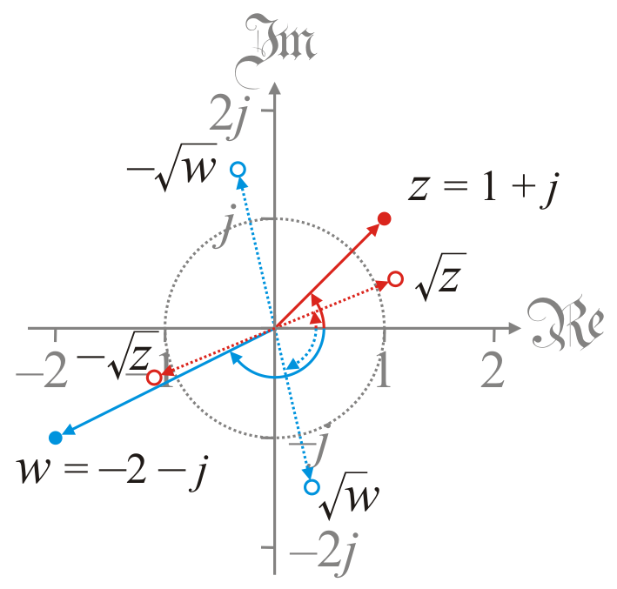
Geometric interpretation
The geometric interpretation of the square root is
The square root of the magnitude
Half the angle if

Slide 10
Properties
Theorem: if and only if
The square root of a complex number on the unit circle remains on the unit circle
Proof: if and only if ,
which is true if and only if or ,
but if and only if z = 0, so it must be that .
QED

Slide 11
Summary
In this topic, we’ve introduced the square root of a complex number
Given any non-zero complex number z,
There are two numbers that when squared equal z
We defined one to be principal square root
The magnitude is the square root of the magnitude
The angle is half the angle if
The square roots of complex numbers on the unit circle remain on that unit circle

Slide 12
References
[1] https://en.wikipedia.org/wiki/Complex_number#Square_root
[2] https://en.wikipedia.org/wiki/Square_root#
Square_roots_of_negative_and_complex_numbers

Slide 13
Acknowledgments
None so far.

Slide 14
Colophon
These slides were prepared using the Cambria typeface. Mathematical equations use Times New Roman, and source code is presented using Consolas.
The photographs of flowers and a monarch butter appearing on the title slide and accenting the top of each other slide were taken at the Royal Botanical Gardens in October of 2017 by Douglas Wilhelm Harder. Please see
https://www.rbg.ca/
for more information.

Slide 15
Disclaimer
These slides are provided for the ne 112 Linear algebra for nanotechnology engineering course taught at the University of Waterloo. The material in it reflects the authors’ best judgment in light of the information available to them at the time of preparation. Any reliance on these course slides by any party for any other purpose are the responsibility of such parties. The authors accept no responsibility for damages, if any, suffered by any party as a result of decisions made or actions based on these course slides for any other purpose than that for which it was intended.

